Slide 1
ENSE 470 milestone 4
Jeremy Cross
Iden Ellia
Abdullah Alasmari

Slide 2
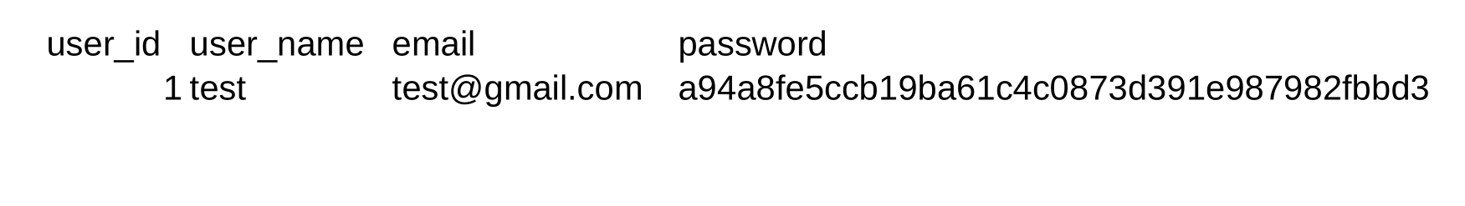
Users

Slide 3
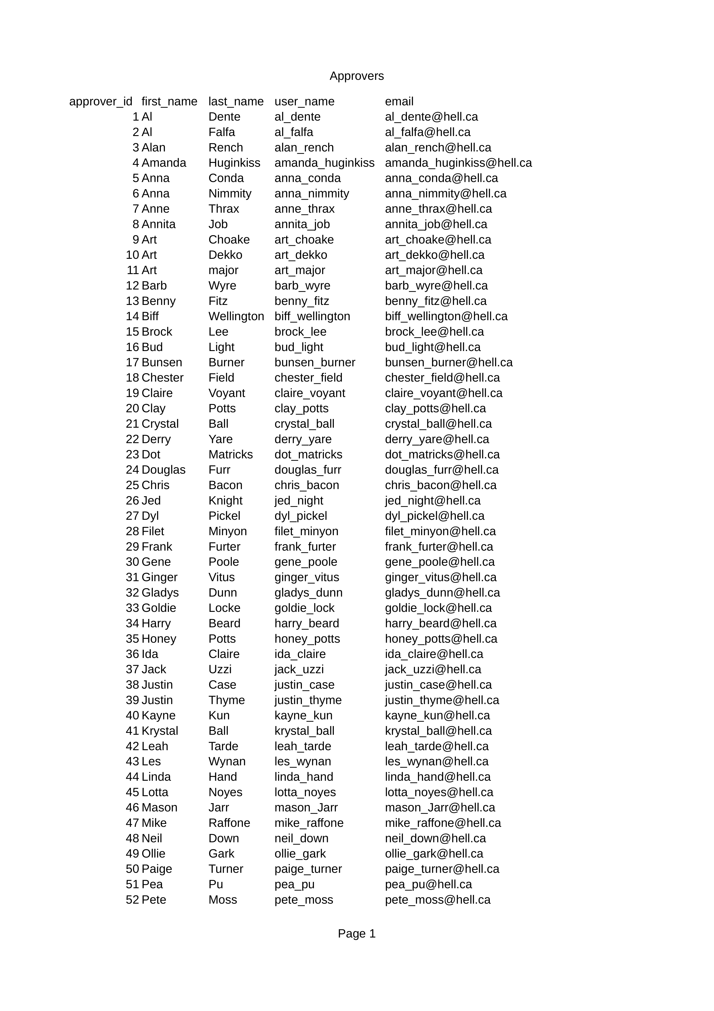
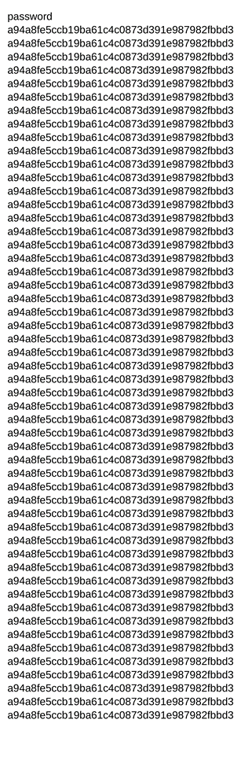
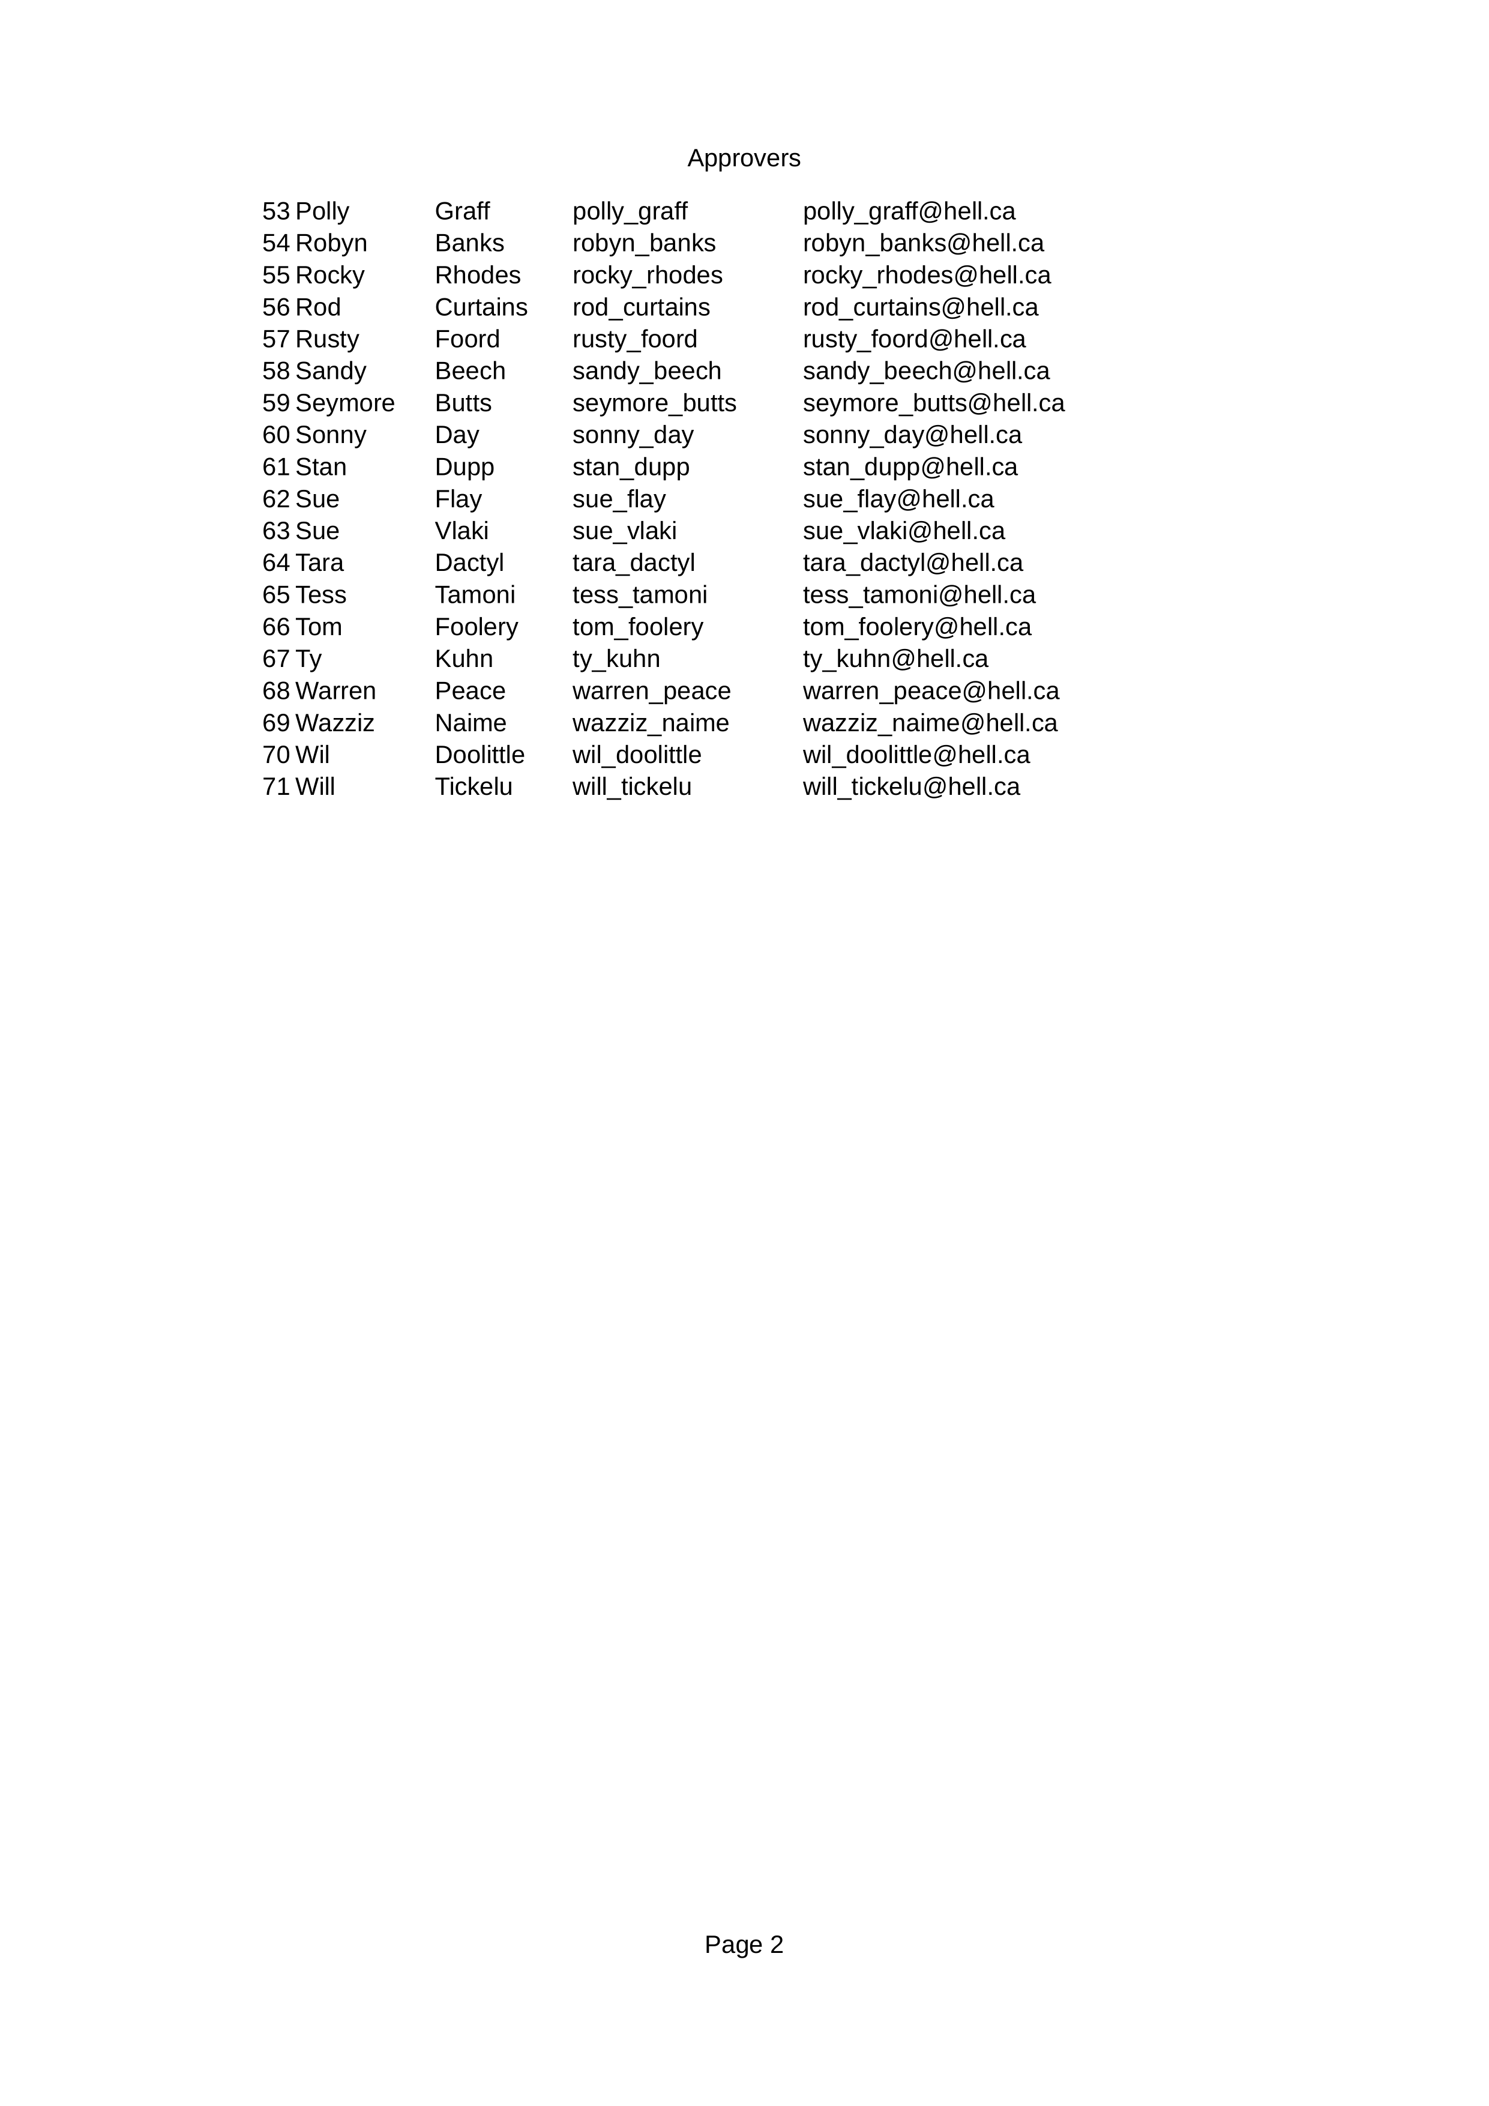
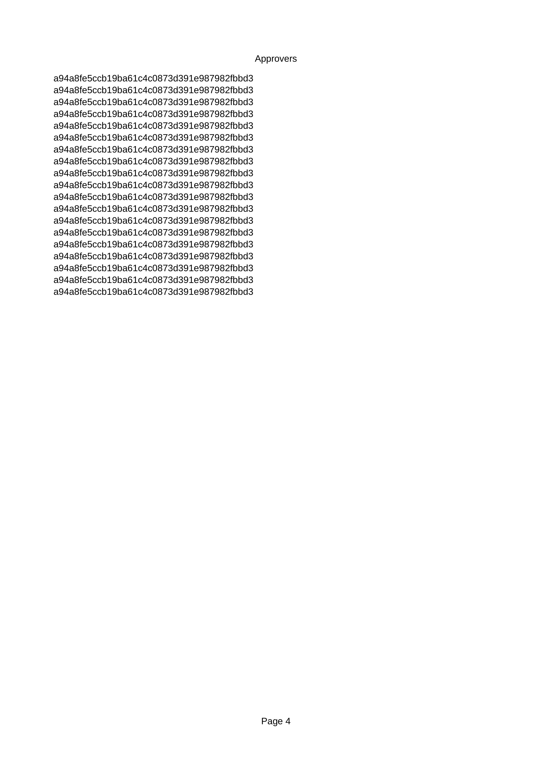
Approvers

Slide 4
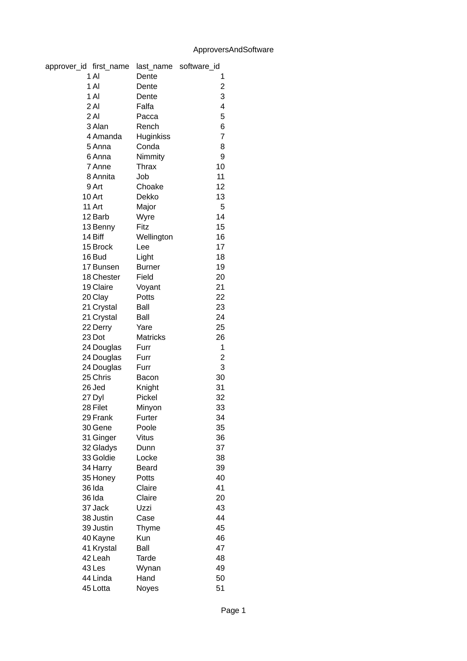
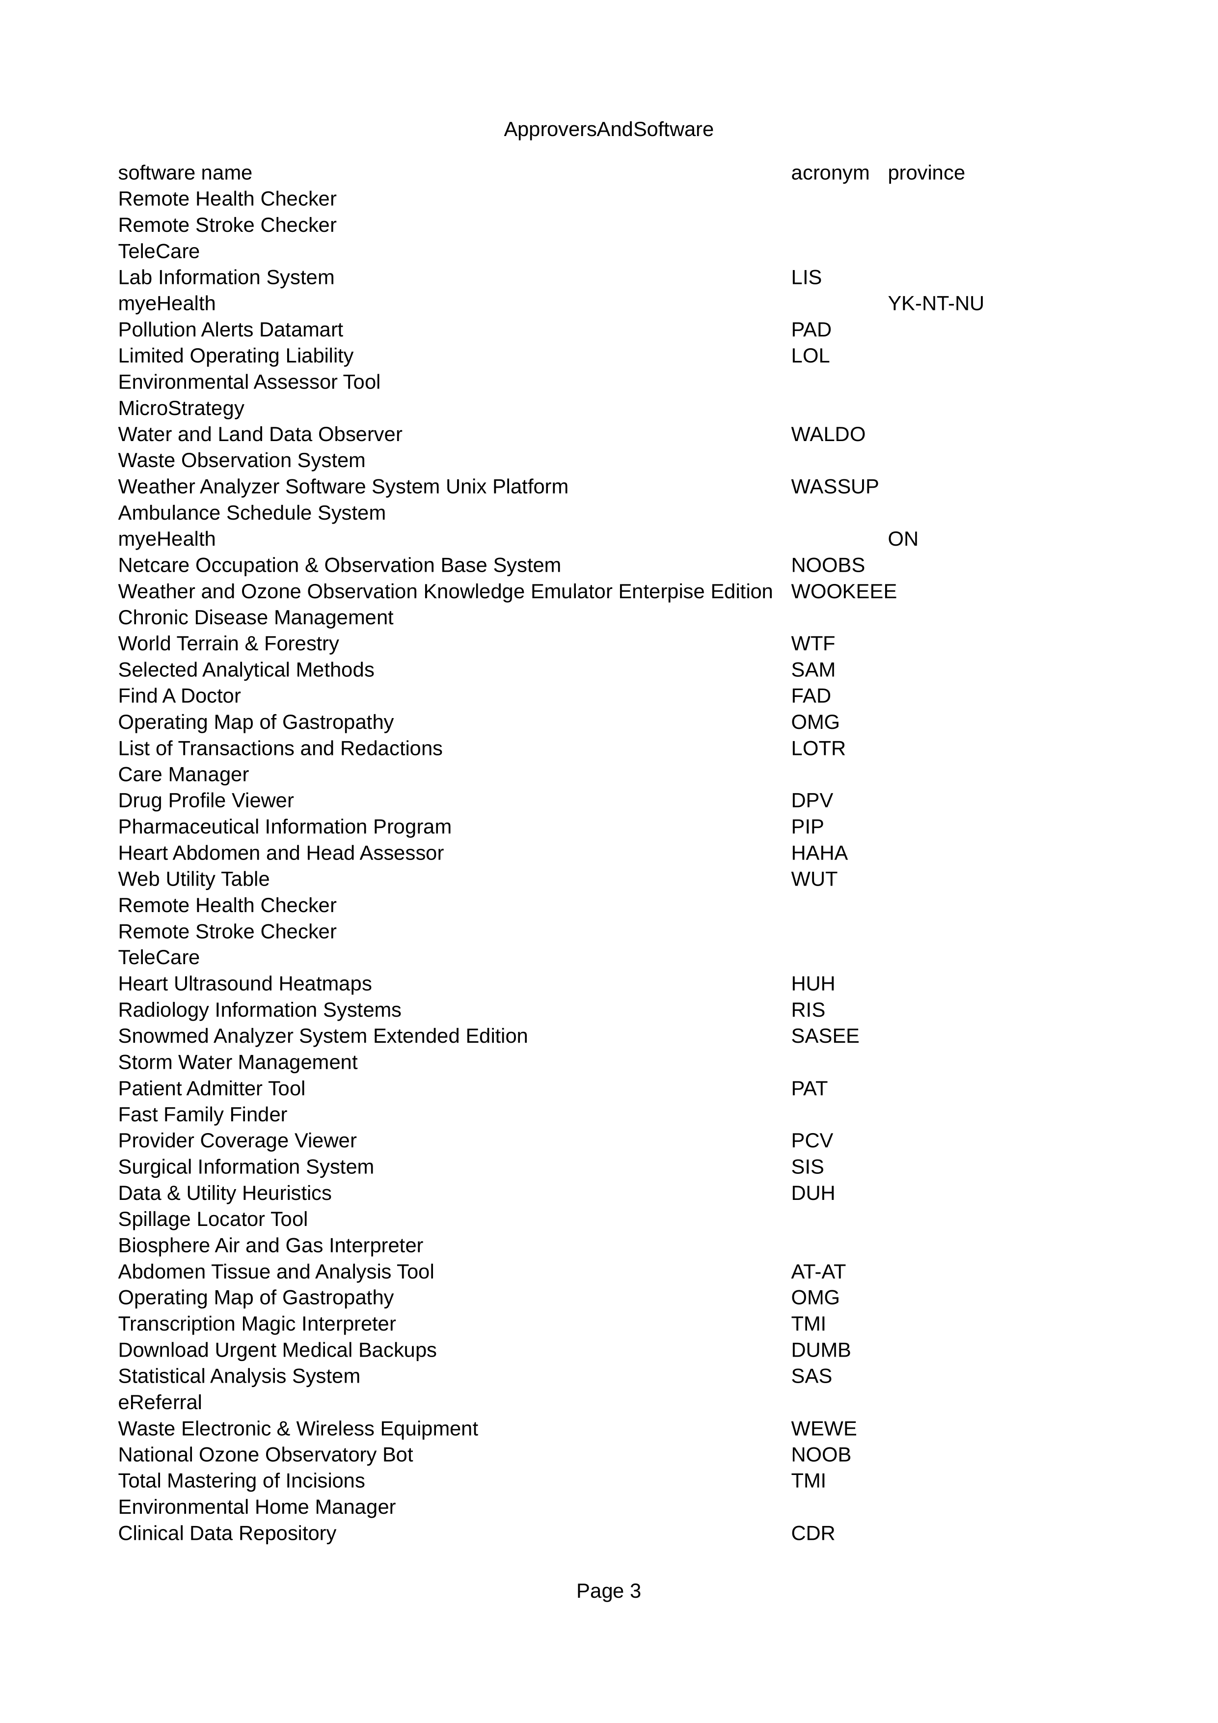
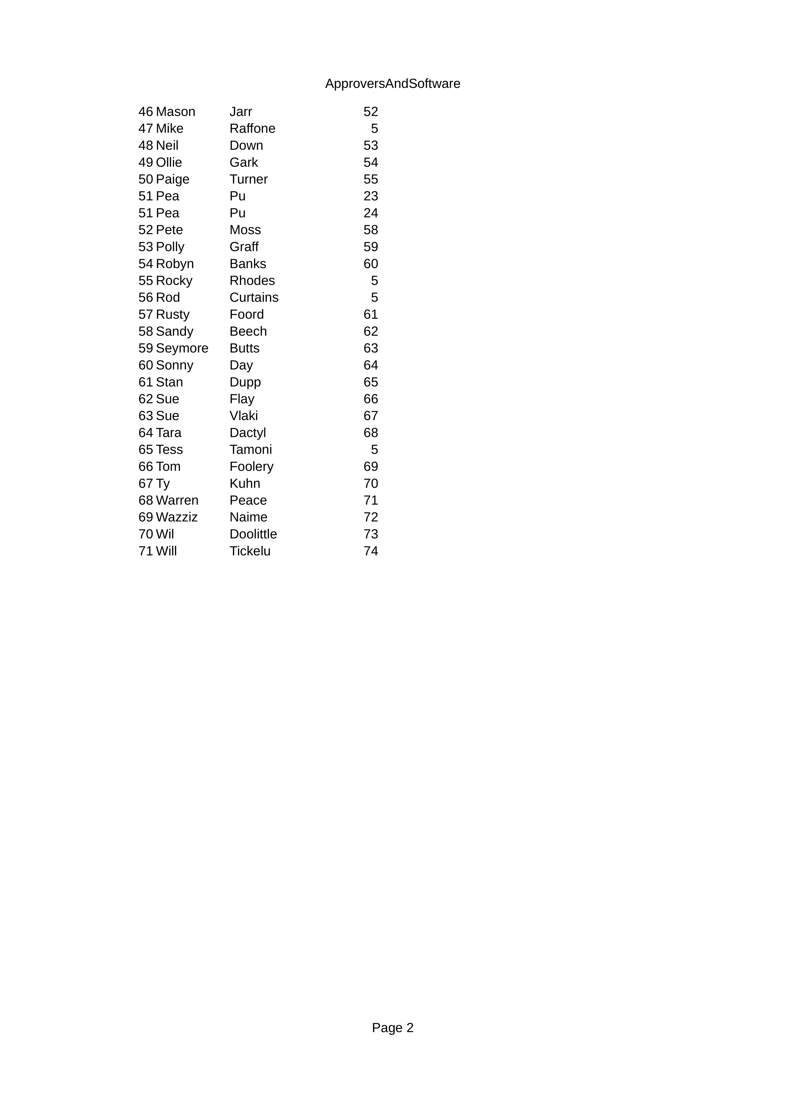
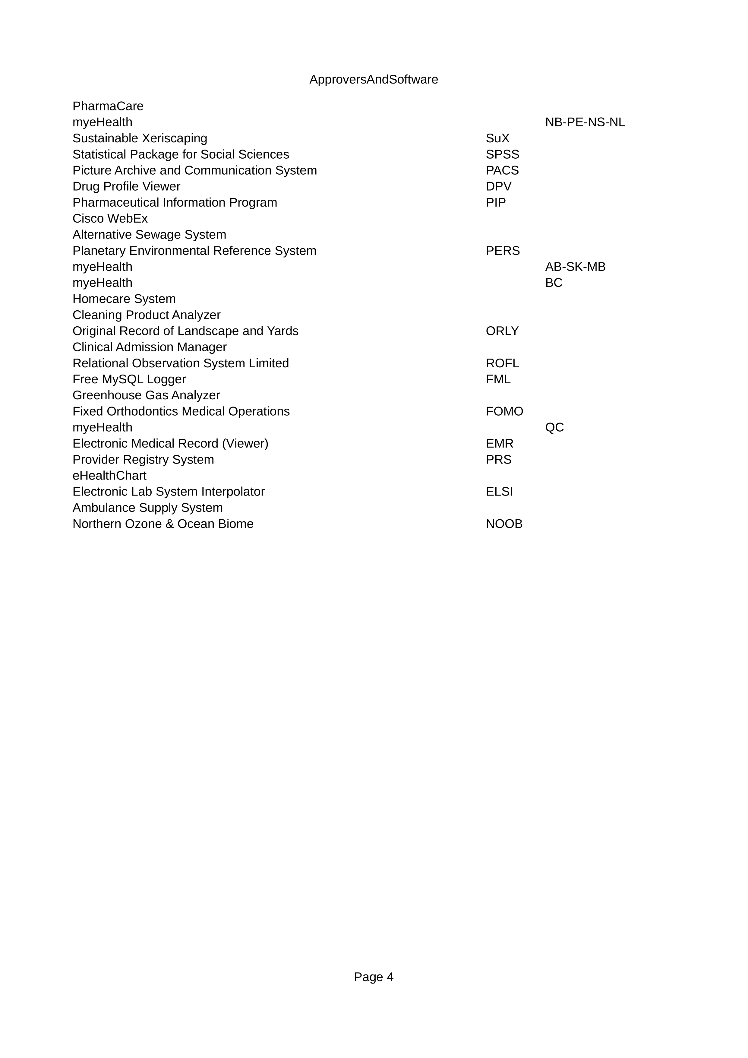
Approvers and software

Slide 5
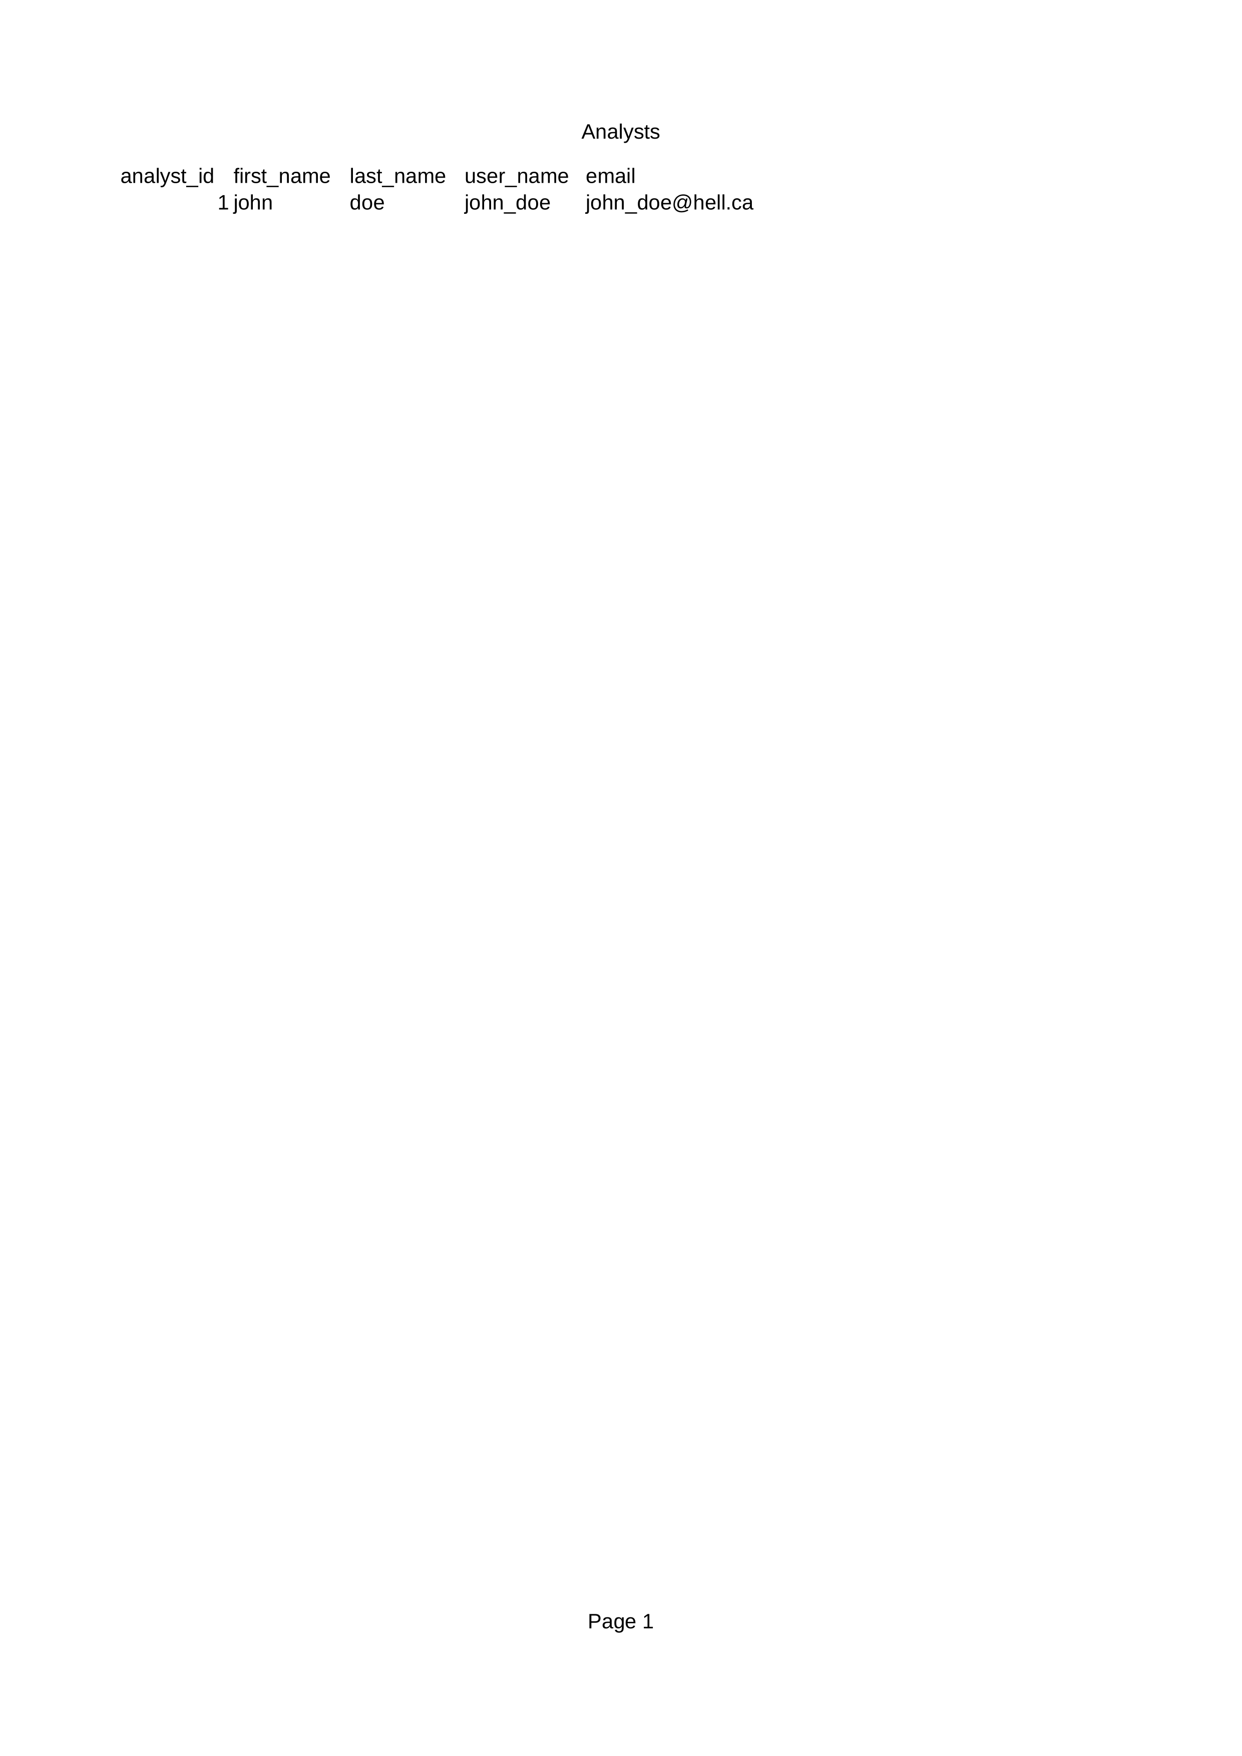

Analyst

Slide 6
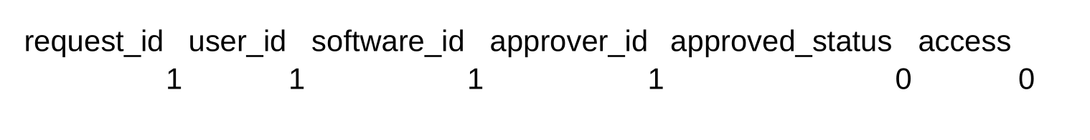
Software Requests

Slide 7
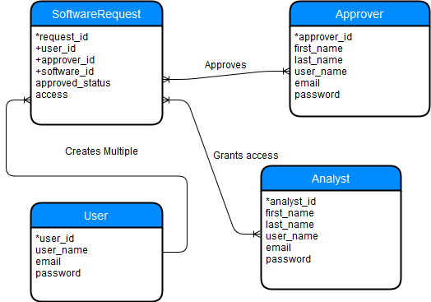
Erd diagram

Slide 8
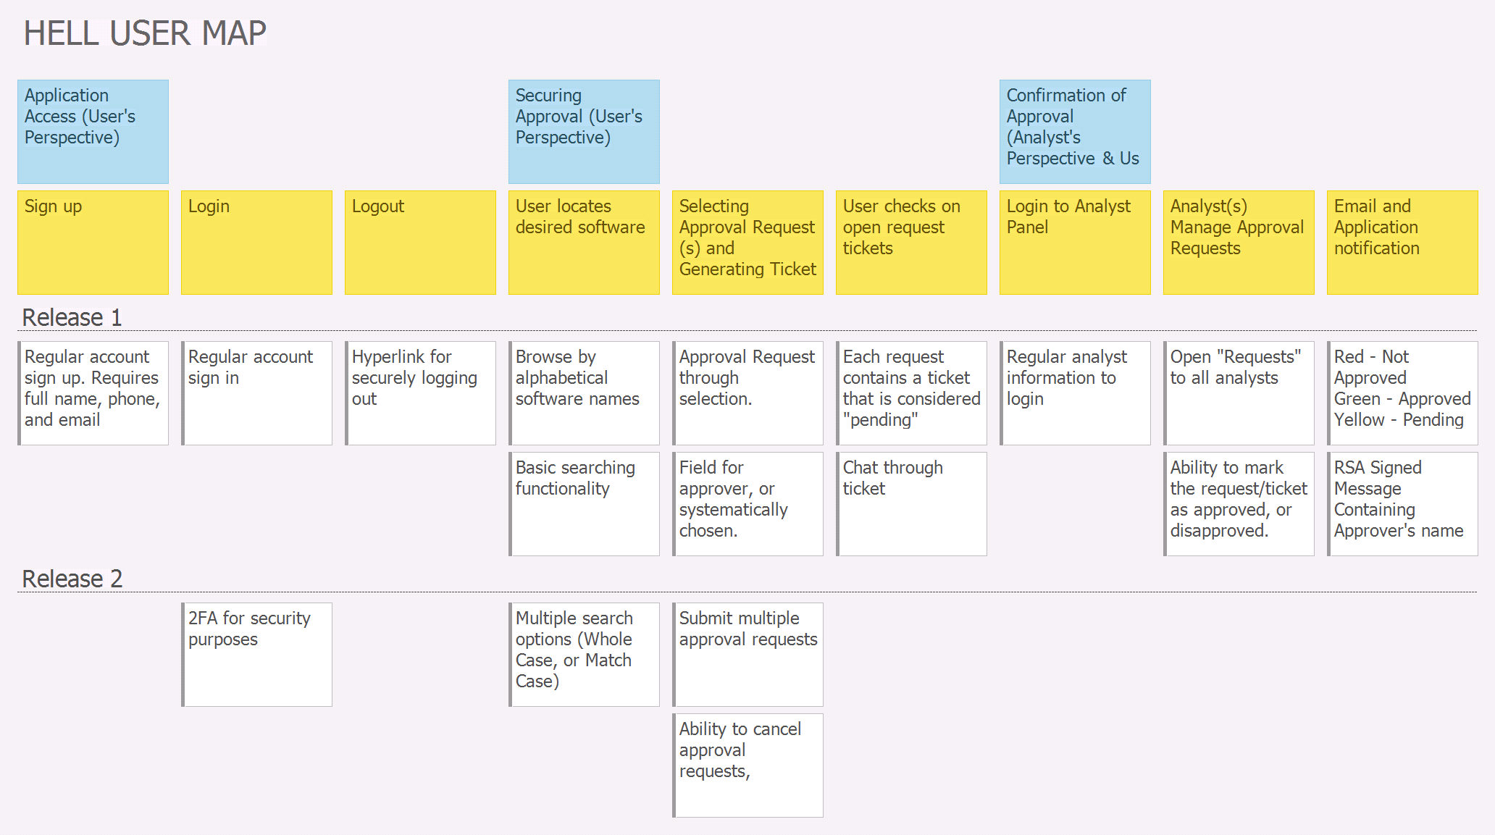
User story map

Slide 9
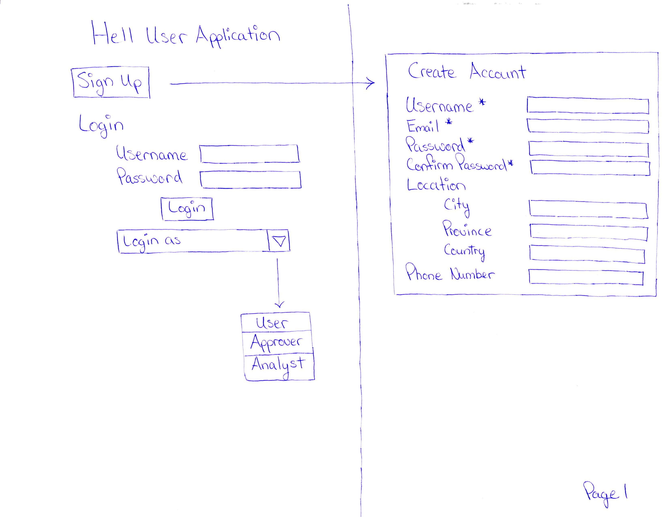

Slide 10
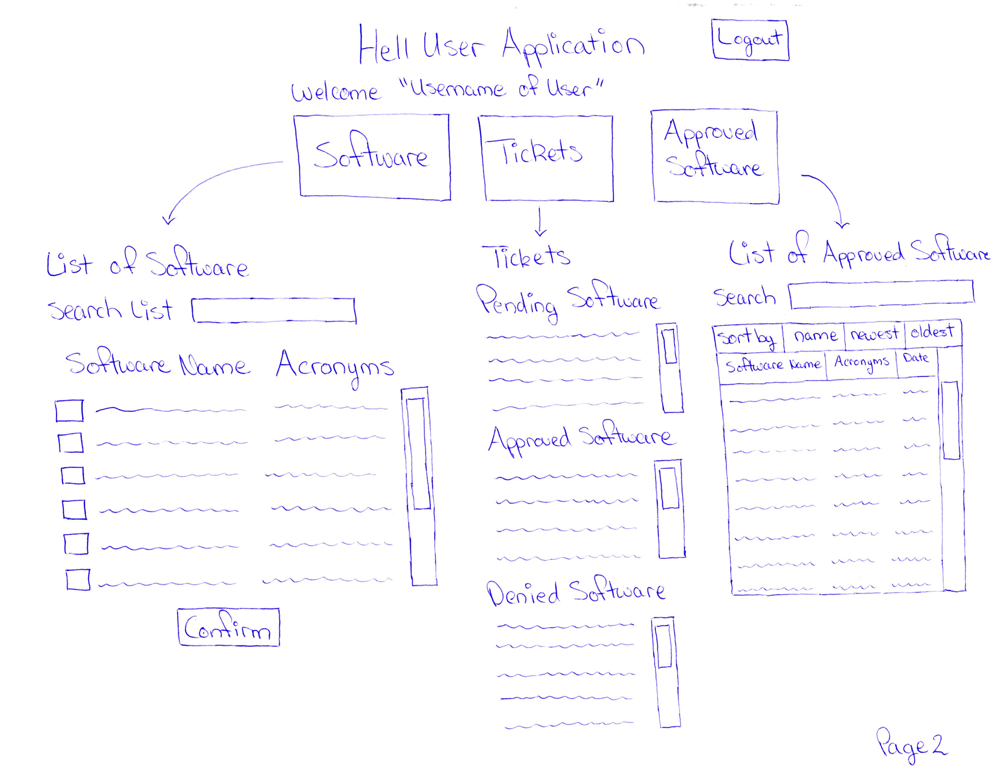

Slide 11
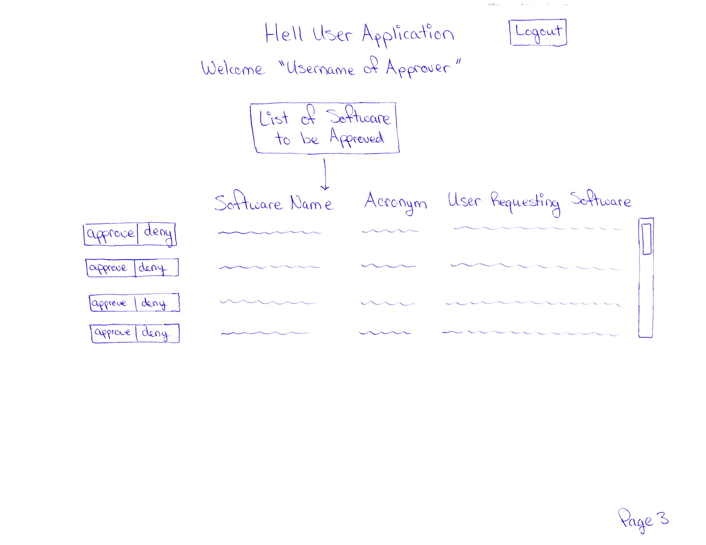

Slide 12
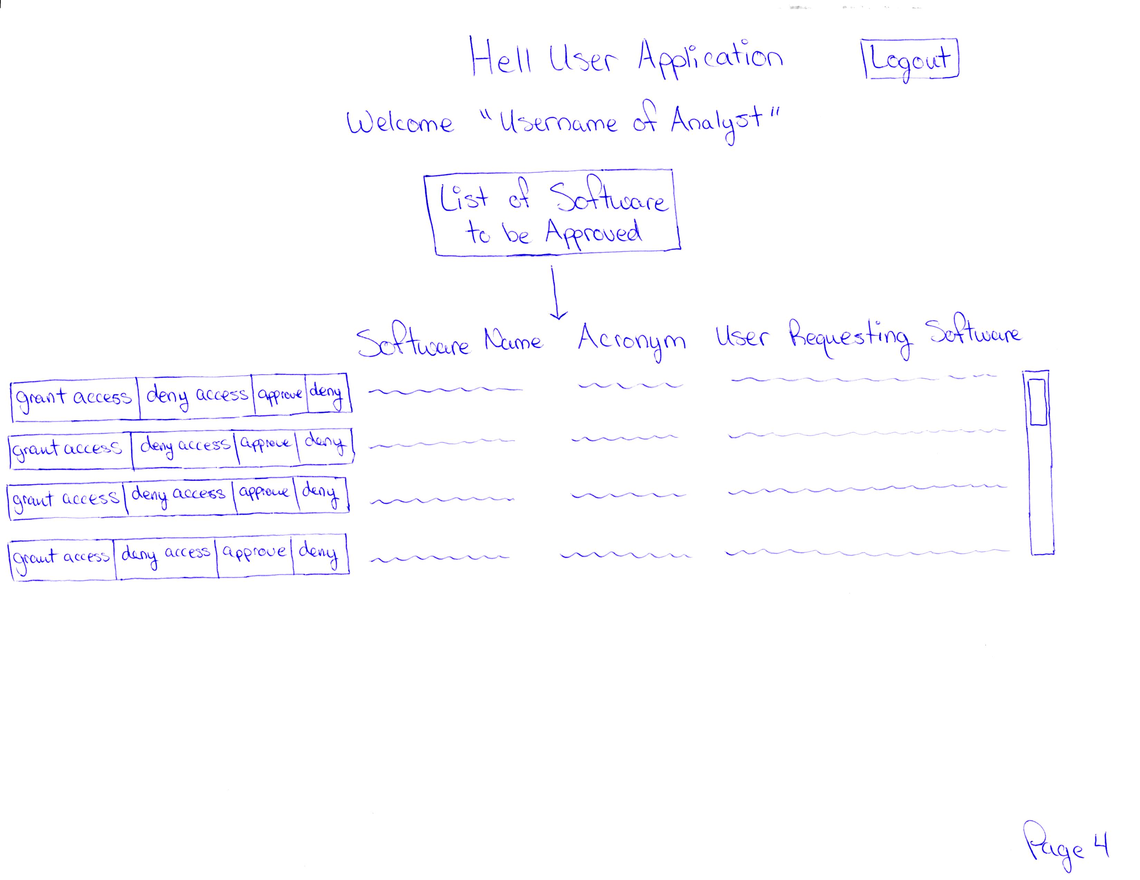

Slide 13
Changes & misc
Have your plans changed since your group’s initial conception and project evolution
Something you saw another team did was intriguing/inspiring
Other groups have interesting ways of representing there designs.
We grouped similar screens together in our Lo-Fi diagrams.
Something you didn’t care for in your initial concept of your future VSM
We felt like our VSM and user story map held up quite well still.

Slide 14
Group reflection
How did you feel about this milestone? What did you like about it? What did you dislike?
We found it to be helpful creating a visual representation for our design. It will help with building our application in later milestones.
What did you learn about yourself as you collaborated and worked through this milestone?
It’s a little challenging trying to represent your ideas visually on paper.
How will you use what you have learned going forward?
We will use the visual representations that we have created here to aid in the development of our application.
It will be useful for other projects down the road.
What “stuff & things” related to this milestone would you want help with?
It was a little difficult to figure out how to utilize the analyst in our design

Slide 15
Questions?

